Slide 1
WHO Global Suicide Data from 1979-2015*: a Slavic Story
Data Science 101
Exploratory Project
By Sydney Davis
TW: suicide

Slide 2
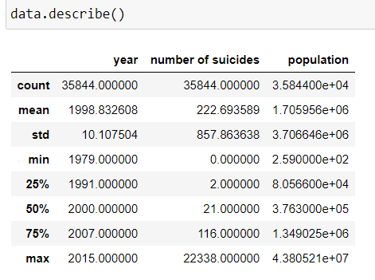
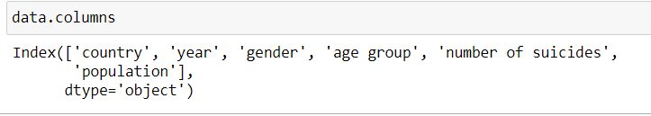
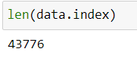
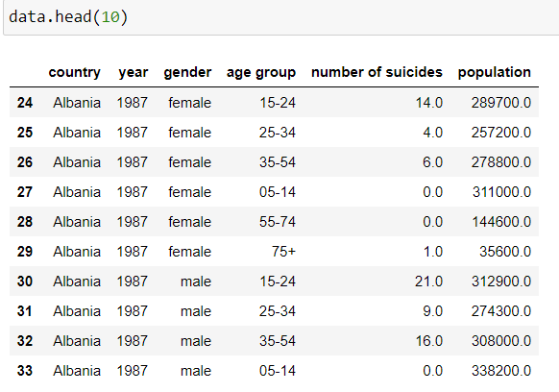
What are we looking at?
Important structural information:
6 columns:
Country name
Year: 1979-2015
Gender: binary
Age group: 6 different categories
Raw number of suicides
Raw number of people within demographic

Slide 3
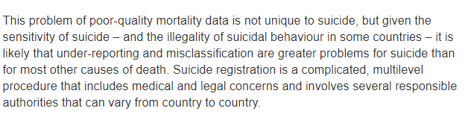
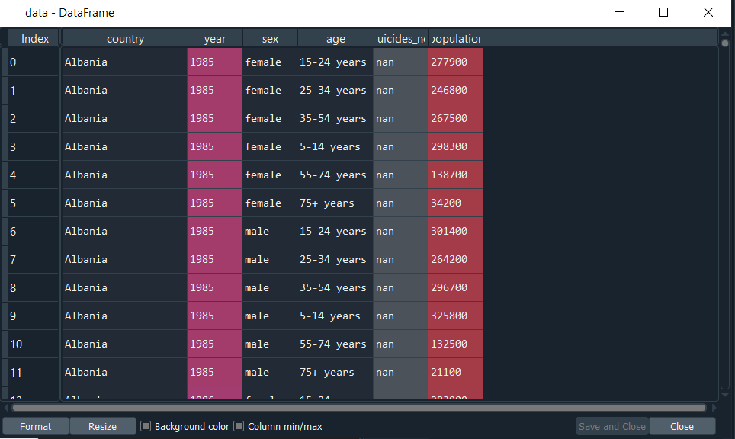
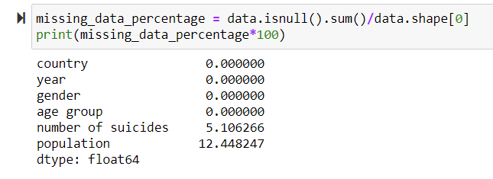
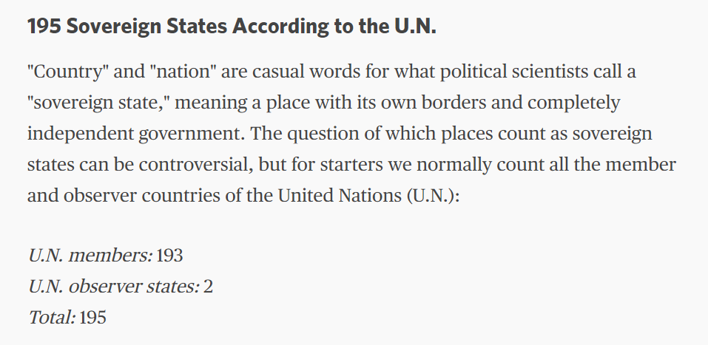
Data + “caveats”
Context
Problem statement
Source: https://www.who.int/mental_health/suicide-prevention/mortality_data_quality/en/
NaNs abound
My solution:
Data = data.dropna()

Slide 4
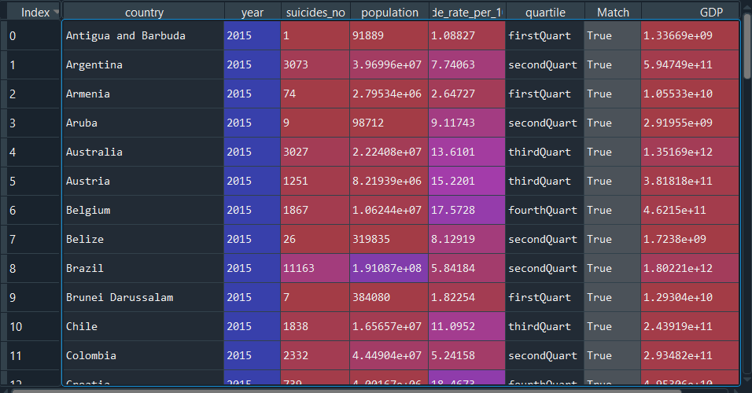
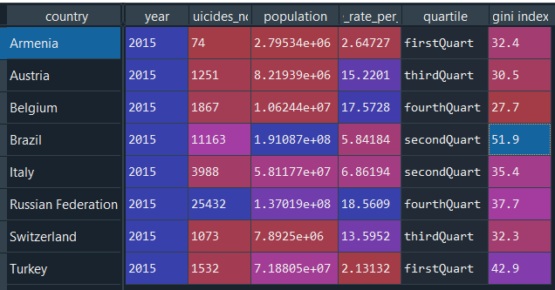
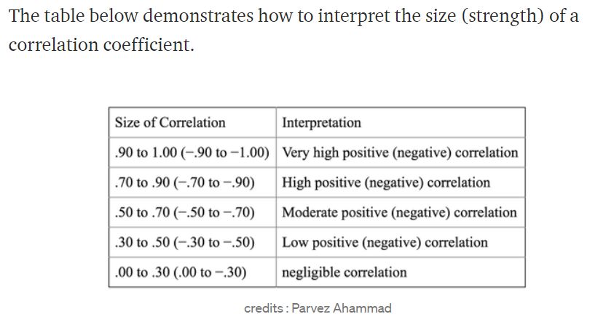
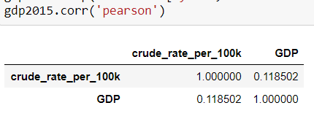
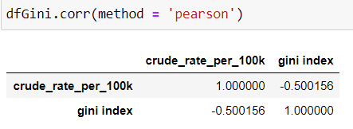
Notes:
-Create call outs
-Make it more readable
-GDP, not statistically significant
-Wasn’t what I was expecting
-”This got me thinking”

Slide 5
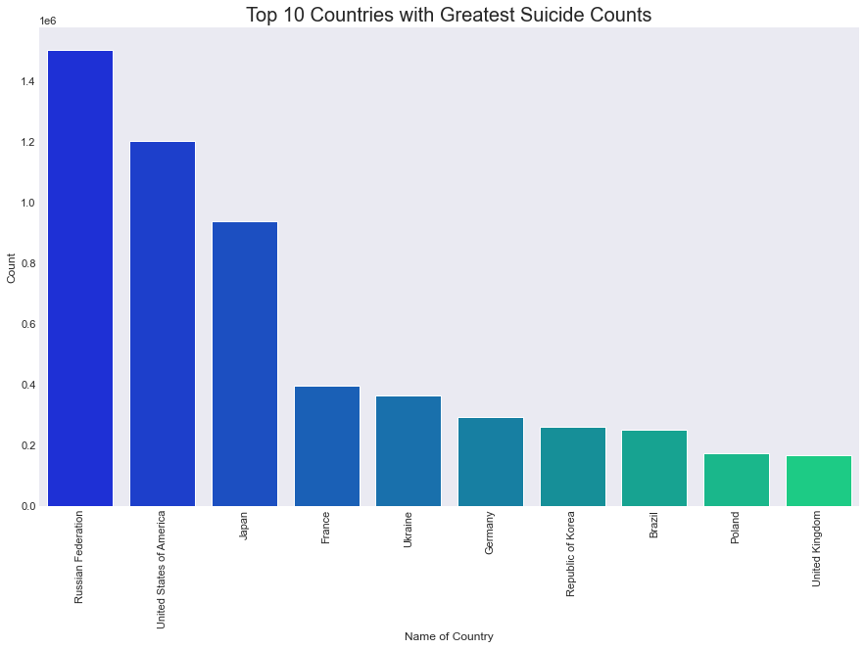
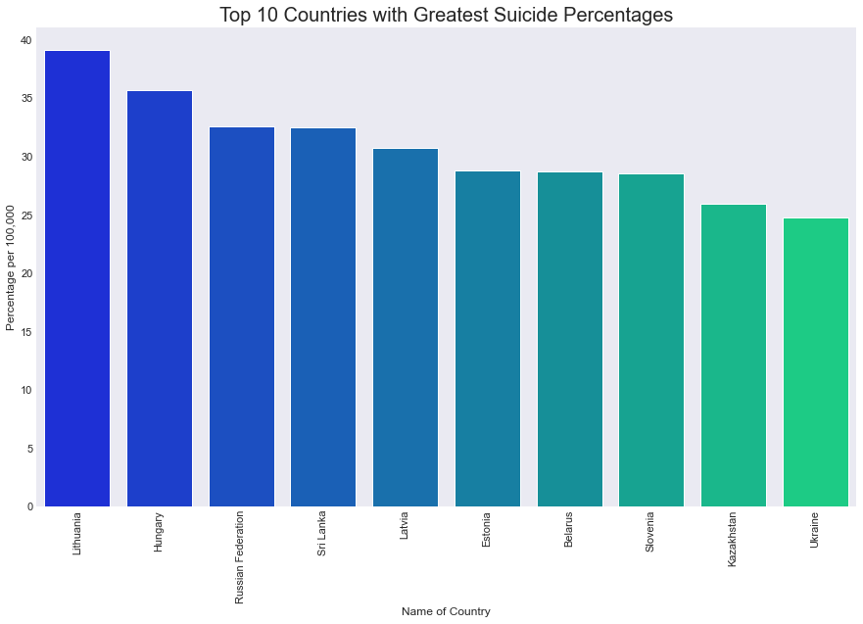
Okay… all developed nations with sizeable populations, how to get real insights out of something like this?
Solution: take the crude rates per 100k!
What do most of these countries have in common? (9/10)

Slide 6
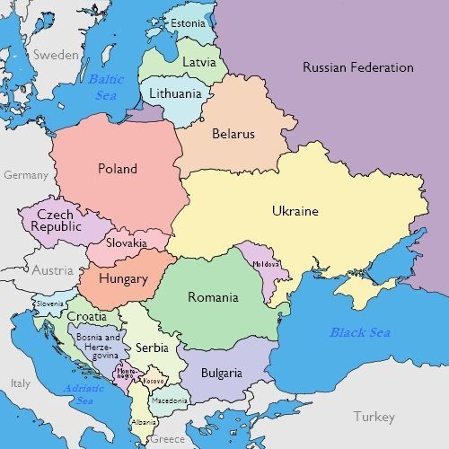
Kazakhstan

Slide 7
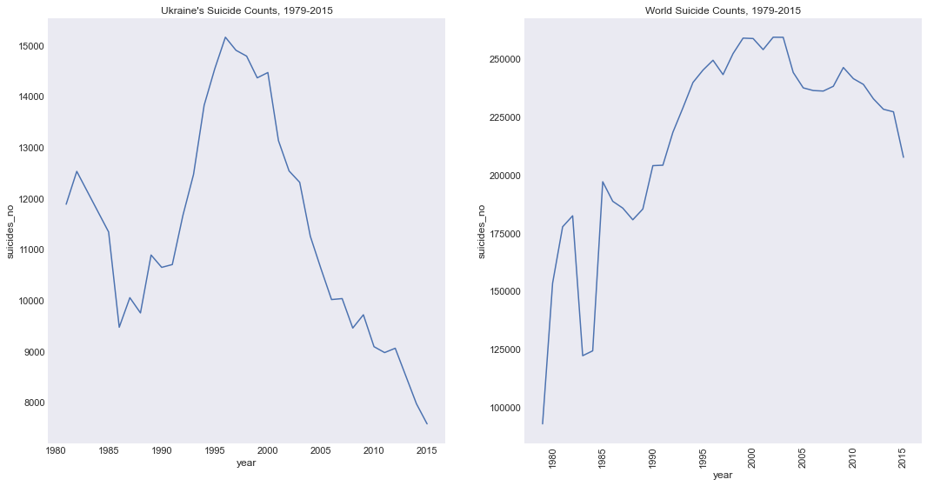
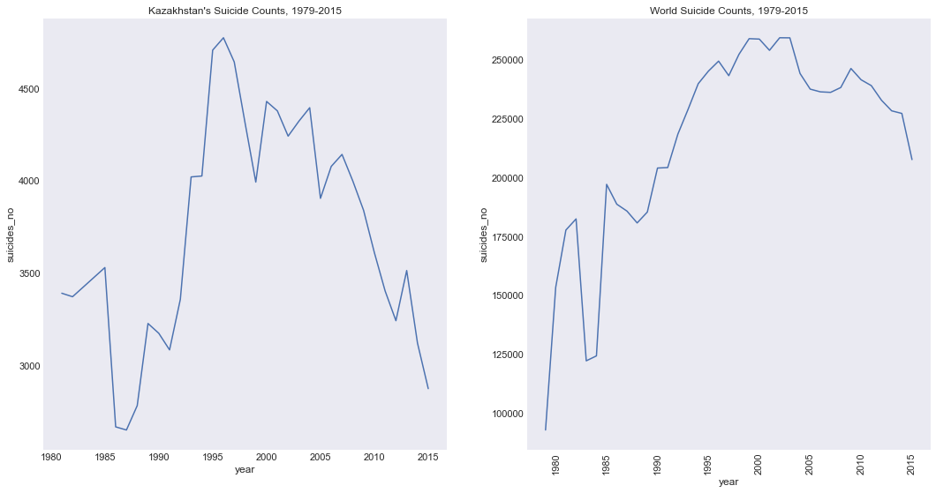
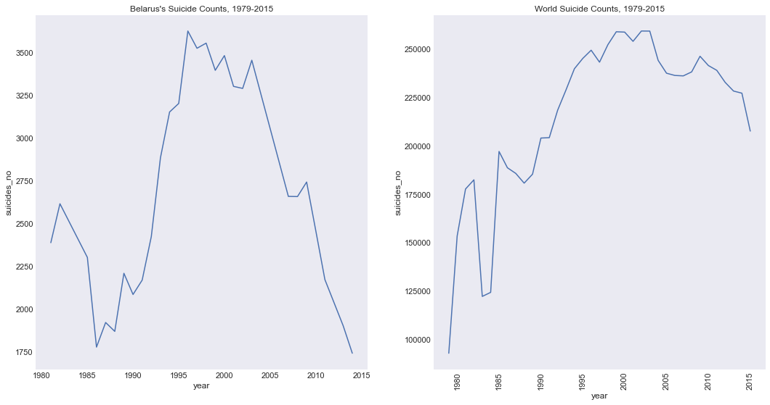
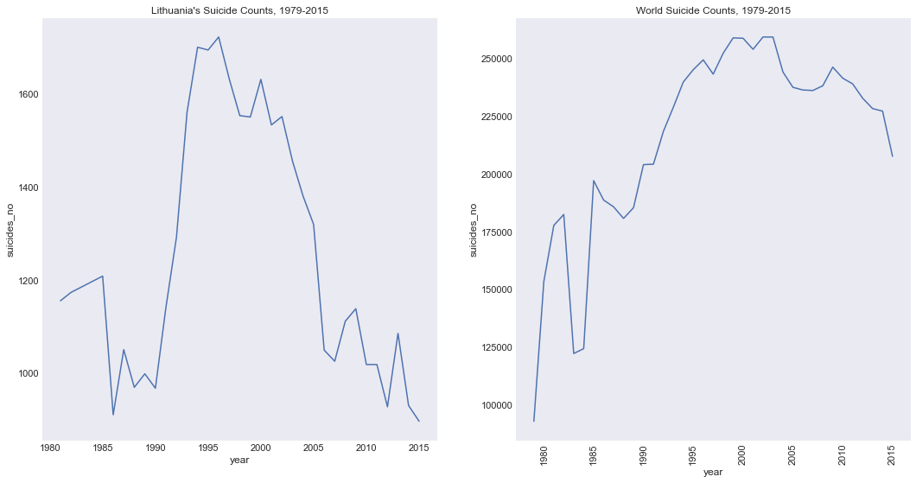
END OF USSR
END OF USSR
Notes:
Because this data is aggregated completely, it’s hard to explain the sudden drop in what looks to be around 1983
According to UN Economic reports, because “According to World Economic Survey 1983, the world economy remained in the grip of recession during 1982 and is only now beginning, in a few places, to show some signs of recovery. The unexpectedly severe contraction in demand that ensued from the anti-inflationary policies set in train by major industrial countries in 1979 and 1980 had brought about a sharp curtailment in the growth of world production and trade in 1981, and the deflationary impact of such policies was aggravated in 1982. In the developing countries as a group, output failed to increase for the first time in the post-war period.”

Slide 8
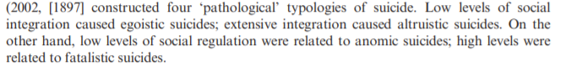
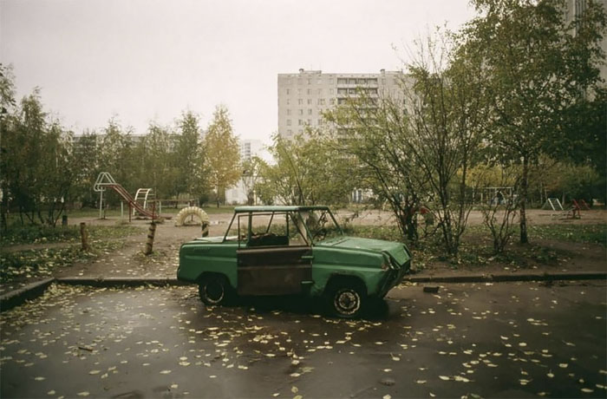
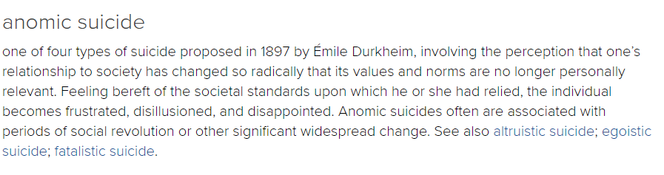
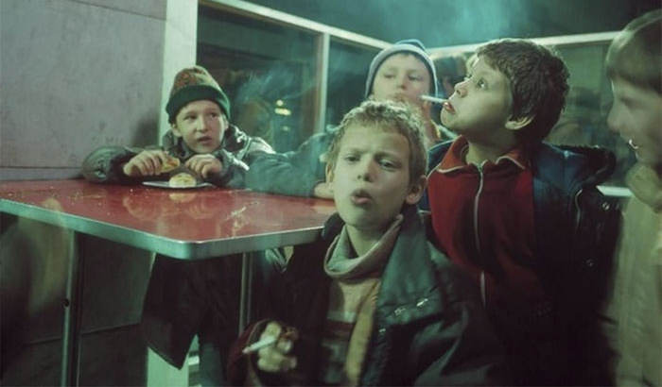

From “Suicide rates and socioeconomic factors in Eastern European countries after the collapse of the Soviet Union: trends between 1990 and 2008”
Photo source: https://www.demilked.com/photography-90s-russia-acta-est-lise-sarfati/
From “The social context of well-being” by Helliwell and Putnam
Notes:
-Give statistical rundown of what Russia was like in the 1990s , or maybe find a quote
-Fix up that conclusion paragraph
-Connect it

Slide 9
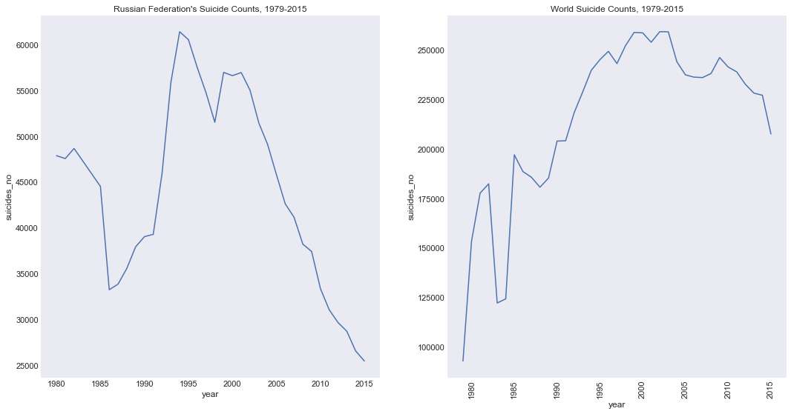
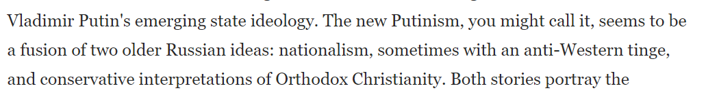
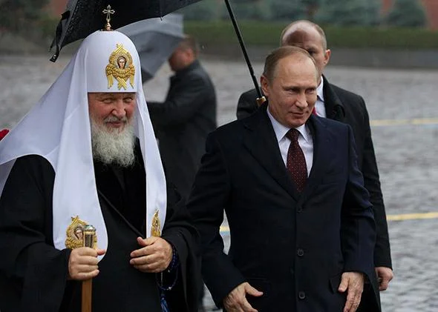
President Vladmir Putin first elected in 2000
End of Soviet Union
Around the time of the Russian Financial Crisis (1998)
Source: https://slate.com/news-and-politics/2014/11/russia-orthodox-church-will-vladimir-putin-eradicate-all-boundaries-between-church-and-state.html

Slide 10
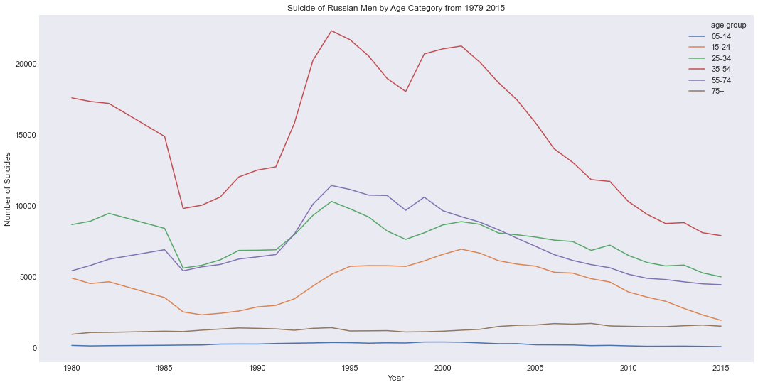
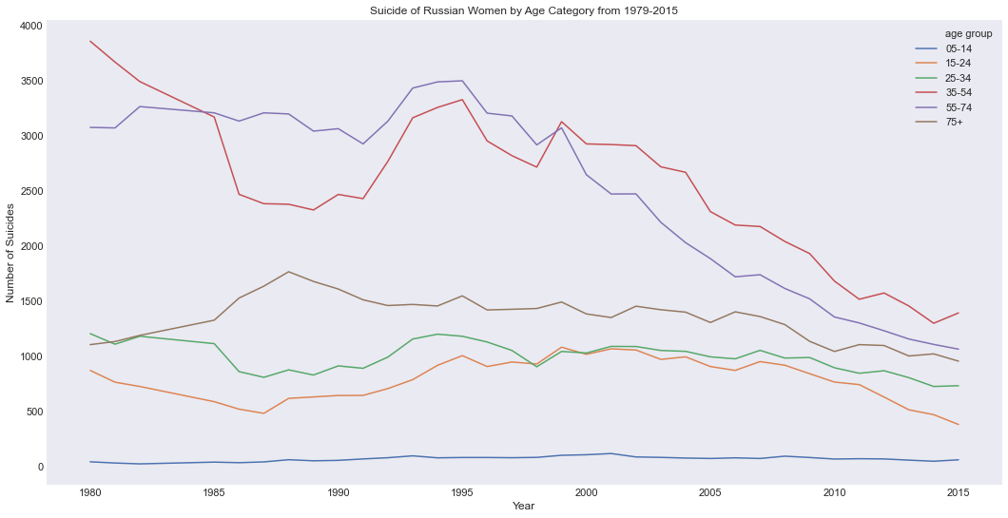
35-54
Possible Justifications:
35-54 year old men committed the most suicide for all years-- caretakers?
55-74
35-54
Possible Justifications:
55-74 year old women were maturing when World War II happened, lost an entire generation of men
Identity of USSR solidified by losses in WWII, destabilized identity

Slide 11
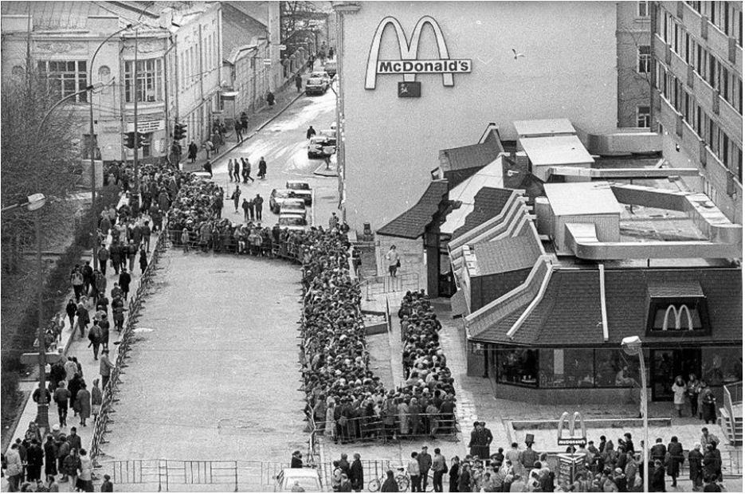
In conclusion: according to WHO data, nations from the post-Soviet bloc have the highest rates of suicide from 1979-2015. With further investigation, a story of social, economic, and psychological upheaval in the early 1990s is unearthed-- a story that had an undeniable impact on the rate of suicide for nearly every demographic.
Questions?
Comments?
Thank you!

